Slide 1
Chapter 7: Database Administration and Security

Slide 2
Objectives
Define terms
List functions and roles of data/database administration
Describe role of data dictionaries and information repositories
Compare optimistic and pessimistic concurrency control
Describe problems and techniques for data security
Understand role of databases in Sarbanes-Oxley compliance
Describe problems and facilities for data recovery
Describe database tuning issues and list areas where changes can be done to tune the database
Describe importance and measures of data availability

Slide 3
Data and Database Administration
Data administration is a high-level function that is responsible for the overall management of data resources in an organization, including maintaining corporate-wide definitions and standards.
Database administration is a technical function that is responsible for physical database design and for dealing with technical issues, such as security enforcement, database performance, and backup and recovery.

Slide 4
Data Administration Functions/Roles
1. Set data policies, procedures, standards
Data policies are statements of the goals of data administration.
Examples: - All users must have passwords.
- Passwords must be changed every six months.
Data procedures are written instructions that describe the steps when perform certain activities. Example: backup and recovery procedures
Data standards are rules to be followed when performing database activities.
Examples: - A password must have a minimum of 8 characters.
- IC numbers, names and birth dates cannot be used as passwords.

Slide 5
Data Administration Functions/Roles
2. Develop information architecture
Data administrators must understand the data and information needed for the organizations and able to lead the development of the information architecture to meet the diverse needs of the organization.
3. Resolve data conflict
Databases are shared and involve data from several departments. A data conflict occurs when two or more departments claims the ownership of the same data. Establishing procedures for resolving such conflicts is essential.
4. Managing the data repository
A data repository is the data storage used by DBMS to store data generated by application programs.

Slide 6
Examples of ineffective data administration that leads to poor data quality
Multiple data definitions of the same data elements in separate databases can cause data integration problems
Missing key data elements can eliminate the value of existing data
Inappropriate data sources and timing can reduce data reliability
Poor query response time and excessive database downtime
Lack of access to data due to damaged, sabotaged, or stolen data files or due to hardware failures
Unauthorized access to data can cause embarrassment to organization

Slide 7
Database Administration Functions/Roles
Analyzing and designing databases
Selecting DBMS and related software tools
Installing/upgrading DBMS
Tuning database performance
Improving database query processing performance
Managing data security, privacy, and integrity
Performing data backup and recovery

Slide 8
Data Warehouse Administration
The significant growth in data warehousing has caused a new role, data warehouse administrator (DWA) to emerge.
Similar to DA/DBA roles
The role of a DWA emphasizes on integration and coordination of metadata and data across many data sources.
Specific roles:
Build and manage decision support applications
Manage data warehouse growth
Develop service-level agreements with suppliers and consumers of data for the data warehouse.

Slide 9
Open Source Database Management
An alternative to proprietary packages such as Oracle, Microsoft SQL Server, or Microsoft Access
MySQL is an example of an open source DBMS
Less expensive than proprietary packages
Source code available, for modification
Absence of complete documentation
Ambiguous licensing concerns
Not as feature-rich as proprietary DBMSs
Vendors may not have certification programs

Slide 10
Database Recovery
Database recovery is the mechanism for restoring a database quickly and accurately after loss or damage.
A DBMS should provide four basic facilities for backup and recovery of a database:
Backup facilities
Journalizing facilities
Checkpoint facility
Recovery manager

Slide 11
a) Backup Facilities
A backup facility provide a periodic backup (nightly or weekly) that produces a backup copy of the portion of or the entire database. Each DBMS provides a COPY utility for this purpose.
Cold backup – database is shut down during backup.
Hot backup – selected portion is shut down and backed up at a given time.
Backups stored in secure, off-site location.

Slide 12
b) Journalizing Facilities
A DBMS must provide journalizing facilities to produce an audit trail of transactions and database changes.
In the event of a failure, a consistent database state can be reestablished, using the information in the journals together with the most recent complete backup.
There are two basic journals, or logs.
Transaction log, which contains a record of essential data for each transaction that is processed against the database.
Database change log, which contains before and after image of records that have been modified by transactions. A before image is simply a copy of a record before it has been modified, and an after image is a copy of the same record after it has been modified.

Slide 13
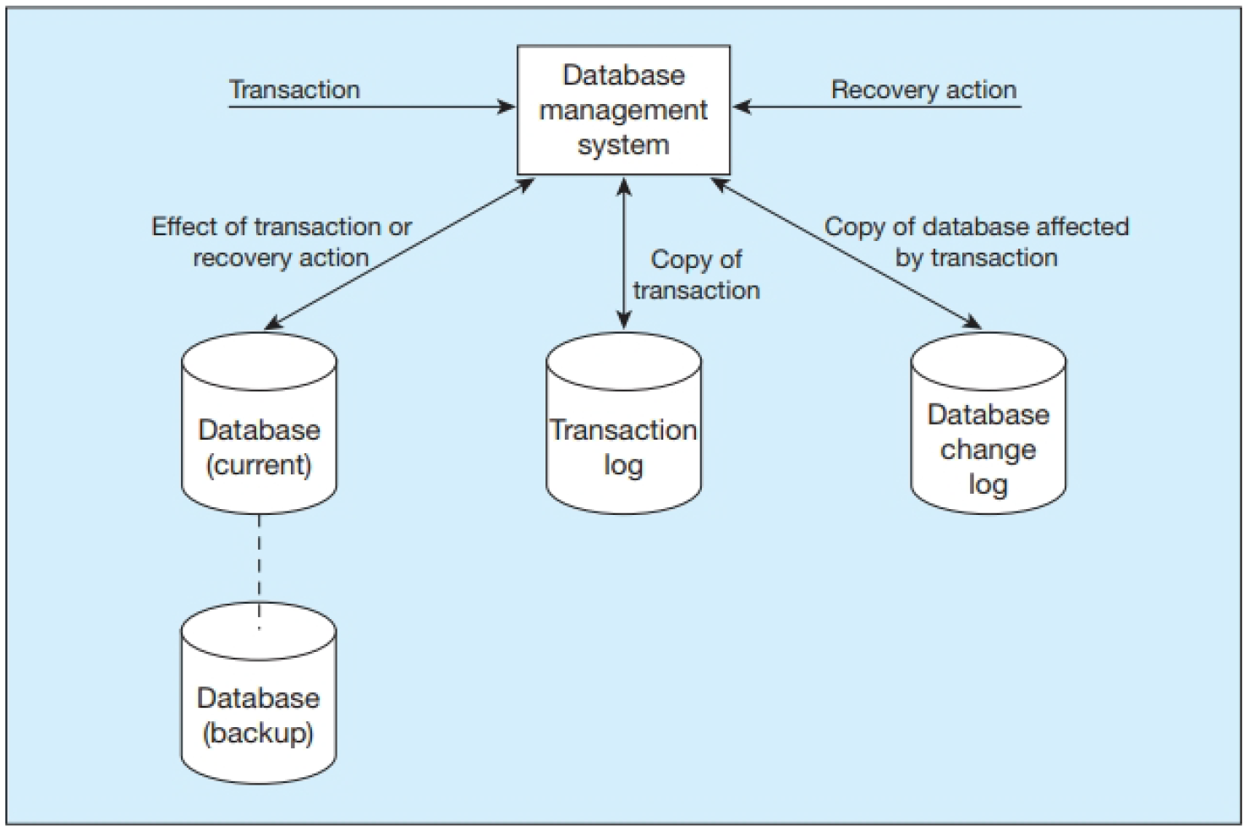
Database audit trail
13

Slide 14
c) Checkpoint Facilities
A checkpoint facility in a DBMS periodically refuses to accept any new transactions. All transactions in progress are completed, and the journal files are brought up to date. At this point, the system is in a quiet state, and the database and transaction logs are synchronized.
A DBMS may perform checkpoints automatically (which is preferred) or in response to commands in user application programs.
Checkpoints should be taken frequently (several times an hour).
When failures occur, it is often possible to resume processing from the most recent checkpoint. Thus, only a few minutes of processing work must be repeated, compared with several hours for a complete restart of the day's processing.

Slide 15
d) Recovery Manager
The recovery manager is a module of a DBMS that restores the database to a correct condition when a failure occurs and then resumes processing user requests.
The recovery manager uses the transaction log and the database change log to restore the database.

Slide 16
Recovery and Restart Procedures
Techniques used in recovery procedures include:
a) Disk Mirroring – switch between identical copies of databases
To be able to switch to an existing copy of a database, the database must be mirrored. That is, at least two copies of the database must be kept and updated simultaneously. When a media failure occurs, processing is switched to the duplicate copy of the database.
This strategy allows for the fastest recovery and has become increasingly popular for applications requiring high availability as the cost of long-term storage has dropped.

Slide 17
Recovery and Restart Procedures
Techniques used in recovery procedures include:
b) Restore/Rerun – reprocess transactions against the backup copy
First, the database is shut down. Then the most recent backup copy of the database is mounted, and all transactions that have occurred since that copy (which are stored on the transaction log) are rerun.

Slide 18
Recovery and Restart Procedures
Techniques used in recovery procedures include:
c) Backward Recovery (Rollback) – apply before images
With backward recovery (also called rollback), the DBMS undo unwanted changes to the database by applying before images of the records to the database. As a result, the database is returned to an earlier state and the unwanted changes are eliminated.
d) Forward Recovery (Rollforward) – apply after images (better than restore/rerun)
With forward recovery (also called rollforward), the DBMS starts with an earlier copy of the database. Applying after images (the results of good transactions) quickly moves the database forward to a later state.

Slide 19
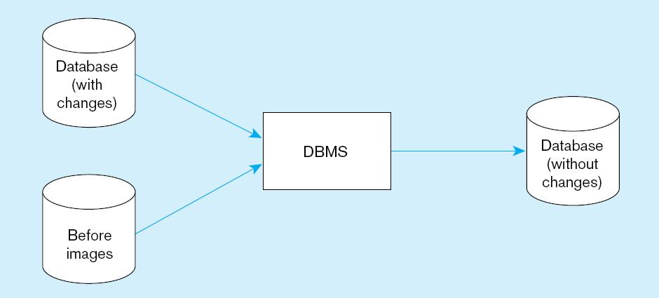
Basic recovery techniques: Rollback

Slide 20
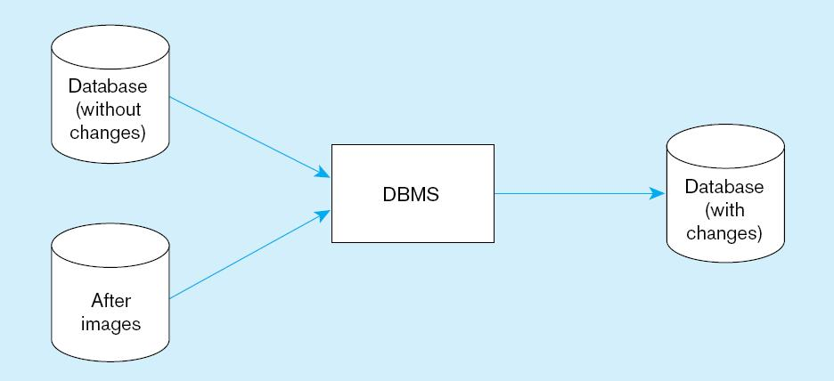
Basic recovery techniques: Rollforward

Slide 21
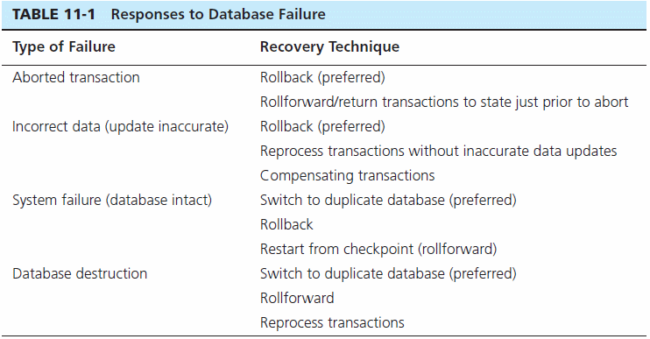

Slide 22
Data Availability
How to ensure data availability?
Hardware failures – provide redundancy or standby components to replace a failing system
Loss of data – database mirroring
Human error – standard operating procedures, training, documentation
Maintenance downtime – automated and non-disruptive maintenance utilities
Network problems – careful traffic monitoring, firewalls, and routers

Slide 23
Data Security
Database security refers to the protection of the data against accidental or intentional loss, destruction, or misuse
Access to data has become more open through the Internet and corporate intranets and from mobile computing devices. As a result, managing data security has become more difficult and time consuming.

Slide 24
Threats to Data Security
Accidental losses due to human error, software and hardware-caused breaches
Theft and fraud (see the figure on next slide)
Loss of privacy (personal data) or confidentiality (corporate data)
Loss of data integrity (data will be invalid or corrupted)
Loss of availability (e.g., through sabotage of hardware, networks, or applications)

Slide 25
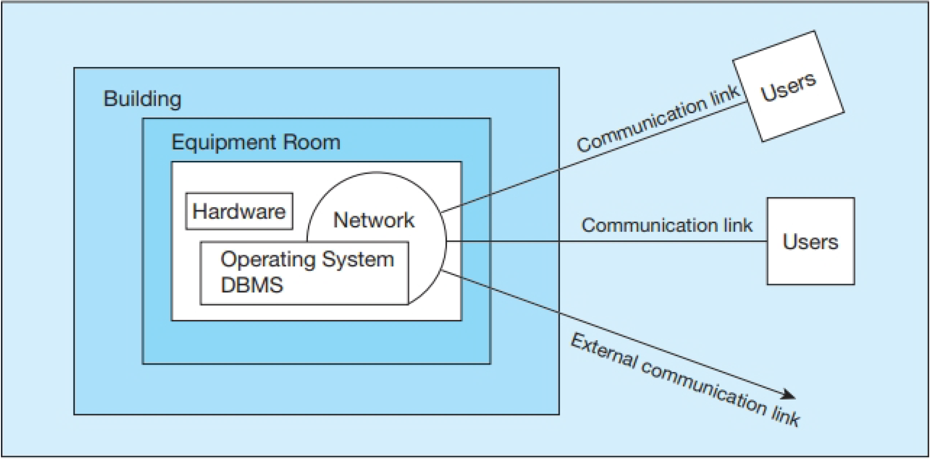
Possible locations of data security threats

Slide 26
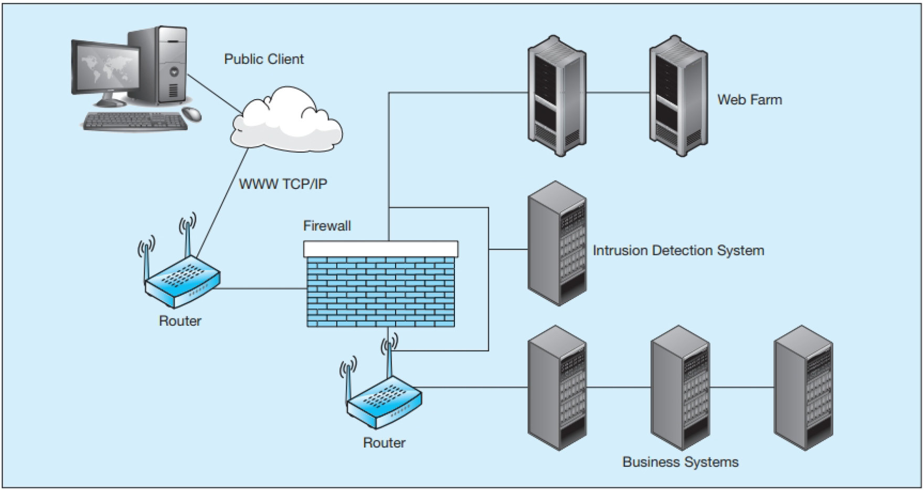
Establishing Internet Security
26

Slide 27
Client – Server Application security
Static HTML files are easy to secure
Standard database access controls
Place Web files in protected directories on server
Dynamic pages are harder to secure
User authentication
Session security
SSL for encryption
Restrict number of users and open ports
Remove unnecessary programs

Slide 28
SSL (Secure Sockets Layer)
Standard security technology for establishing an encrypted link between a web server and a browser.
This link ensures that all data passed between the web server and browsers remain private and secure.

Slide 29
Database Software Security Features
Views or subschemas
Integrity controls
Authorization rules
User-defined procedures
Encryption
Authentication schemes
Backup, journalizing, and checkpointing

Slide 30
Views and Integrity Controls
Views
Subset of the database that is presented to one or more users.
User can be given access privilege to view without allowing access privilege to underlying tables.
Integrity Controls
Protect data from unauthorized use
Domains – set allowable values
Assertions – enforce database conditions
Triggers – prevent inappropriate actions, invoke special handling procedures, write to log files

Slide 31
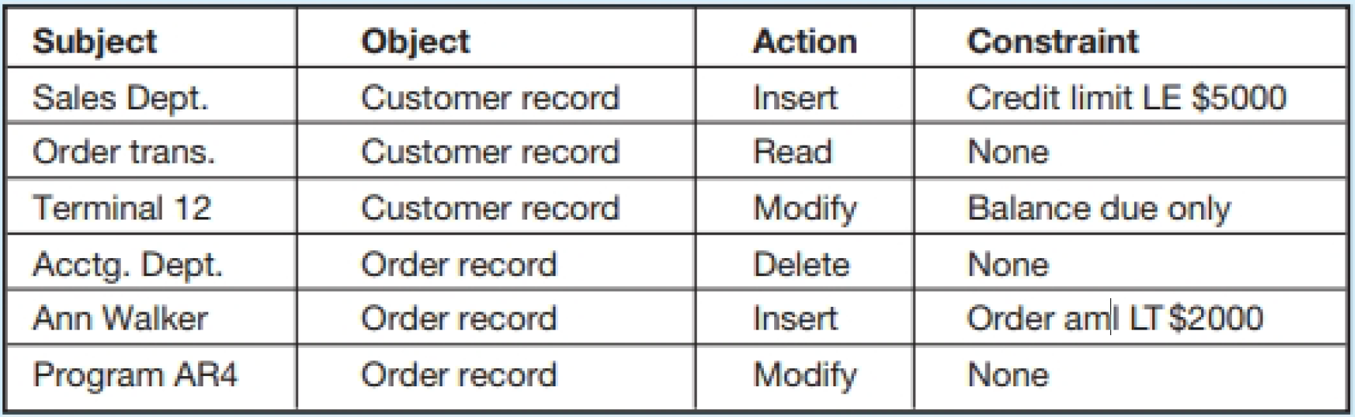
Authorization Rules
Authorization rules are controls incorporated in the data management system restrict access to data and also restrict actions that people can take on data.
Authorization matrix

Slide 32
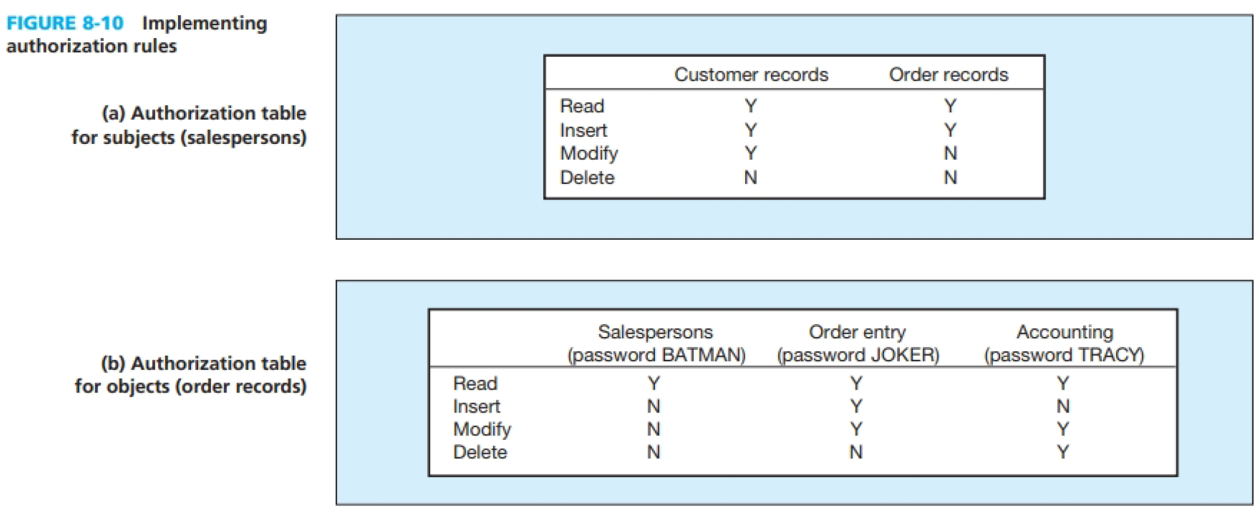

Slide 33
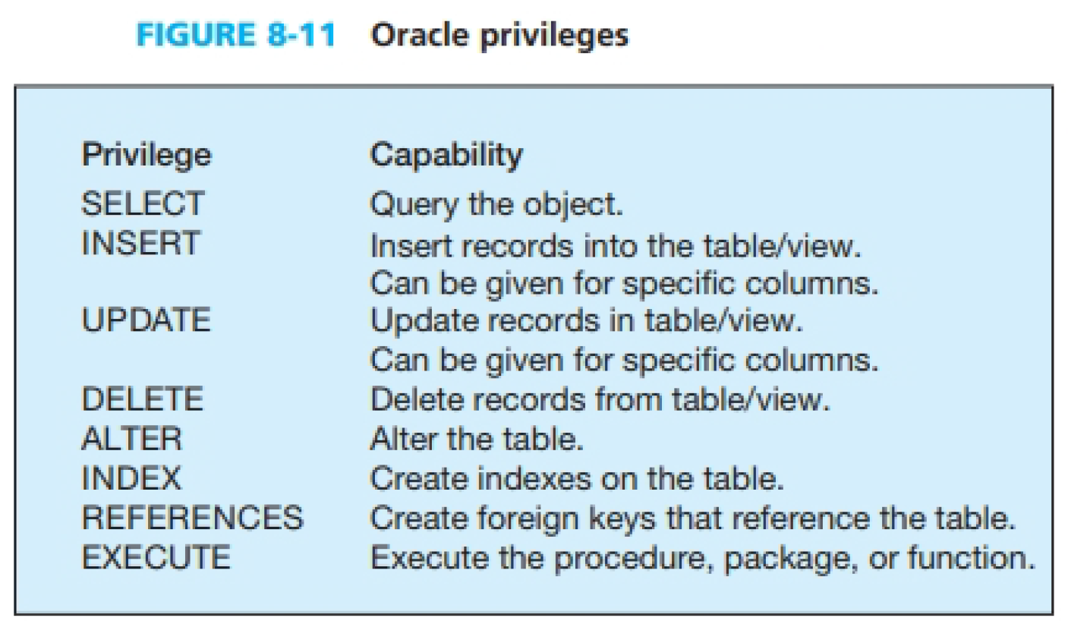

Slide 34
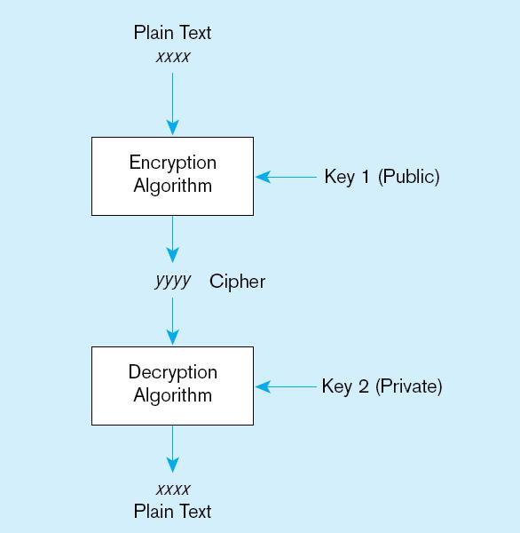
Basic two-key encryption
Encryption – the coding or scrambling of data so that humans cannot read them
Secure Sockets Layer (SSL) is a popular encryption scheme for TCP/IP connections.
34

Slide 35
Authentication Schemes
Goal – obtain a positive identification of the user
Passwords: First line of defense
Should be at least 8 characters long
Should combine alphabetic and numeric data
Should not be complete words or personal information
Should be changed frequently

Slide 36
Authentication Schemes (cont.)
Strong Authentication
Passwords are flawed:
Users share them with each other
They get written down, could be copied
Automatic logon scripts remove need to explicitly type them in
Unencrypted passwords travel the Internet
Possible solutions:
Two factor – e.g., smart card plus PIN
Three factor – e.g., smart card, biometric, PIN

Slide 37
Logical Access to Data
Personnel controls
Hiring practices, employee monitoring, security training, separation of duties
Physical access controls
Swipe cards, equipment locking, check-out procedures, screen placement, laptop protection

